Slide 1
JavaScript - Team Work
Canvas Monster - project
Developed by
Cookie Monster team
N.Nanev, L.Mitkov and N.Petrov
Date: 19.June 2014

Slide 2
Overview
Create paint-like application in JavaScript under following conditions:
Using Canvas
Animations to be created with KanvasJS

Slide 3
Project Features
Drawing basic shapes like:
Lines
Rectangles
Circles
Brush tool - free ride of the mouse pointer
Erase painted by “rubber” like tool
Change the size and color of the painting tool
Image
Save the image

Slide 4
File structure
./index.html – main html file
./styles/style.css – css styling of the html
./libraries/kinetic-v5.1.0.min.js – KineticJS library
./scripts/drawJS.js – JS code responsible for drawing
./scripts/playAdd.js – animated advertisement

Slide 5
Code structure
window.onload
drawJS.js
var definition
Attach - mousedown, mousemove and mouseup event listeners
Functions used:
ev_canvas()
changeDrawingTool()
isToolSelected()
changeAppearanceOfButton()
deselectAllTools()
deselectAllButtons()
changeColor()
changeWidth()
clearCanvas()
showImageInput()
inputPicture()
saveCanvas()
img_update()
animation.js
createLogoAnimation()
initializeCanvas()
telerikLogo()
telericText()
text()
point()
animation()

Slide 6
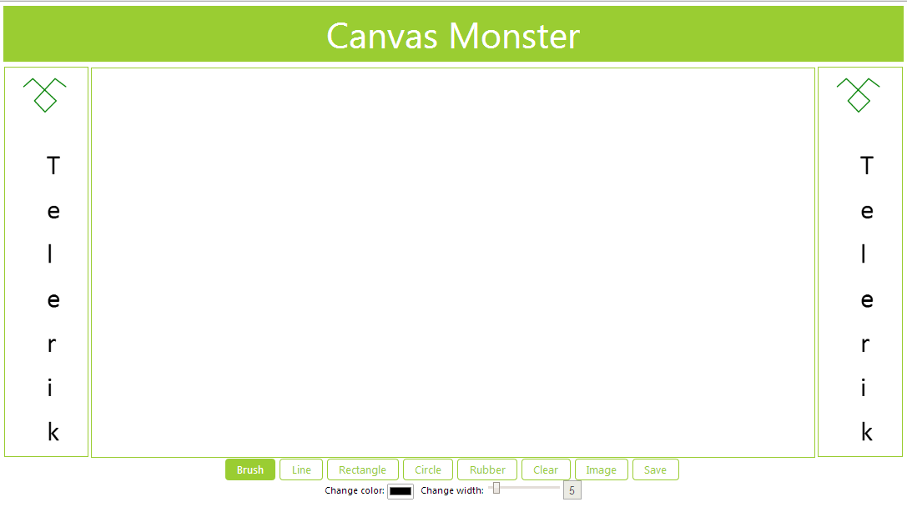
Preview
Painting area
Animated Add
Animated Add
TOOL BOX

Slide 7
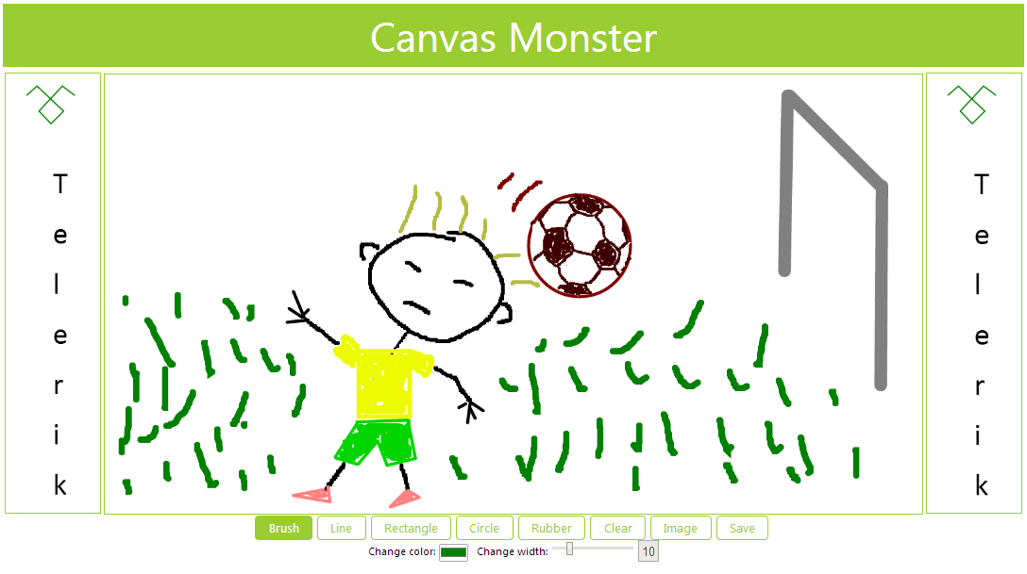
Preview

Slide 8
Thank you for your attention!

